Slide 1
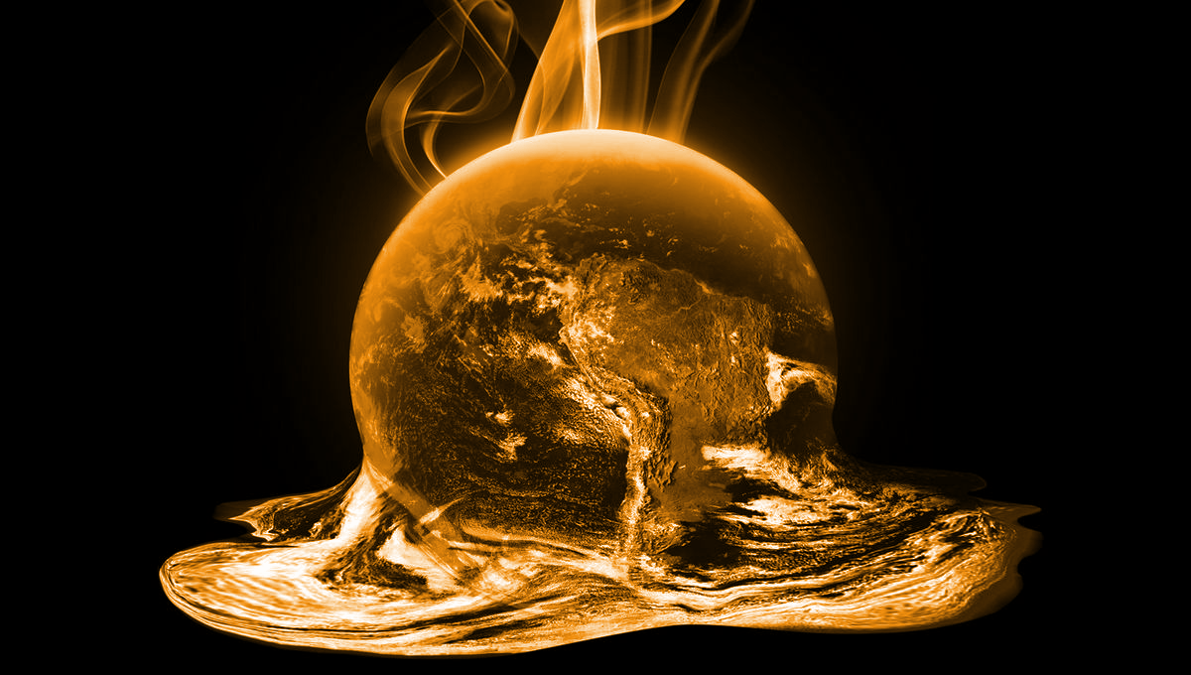
Global Warming Kills People

Slide 2
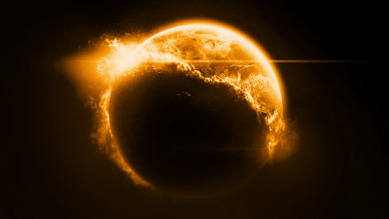
Questions Asked: Does increasing temperatures lead to higher rates of cancer?
Does global warming increases mortality rate on a national level? How does climate change affect state mortality rate of Cancer.
Based on our analysis using official datasets from WHO and NOAA, our conclusion is that increasing global warming is leading to higher cancer related mortality rates in the US.

Slide 3

Think of it this way: What’s the difference between 0 and 1 degree Celsius? Well, that’s the difference between ice and water. One degree can have a huge effect on a global scale in the natural world.

Slide 4
Datasets and Analysis
Causes of Death in US
Climate Change Data in US

Slide 5
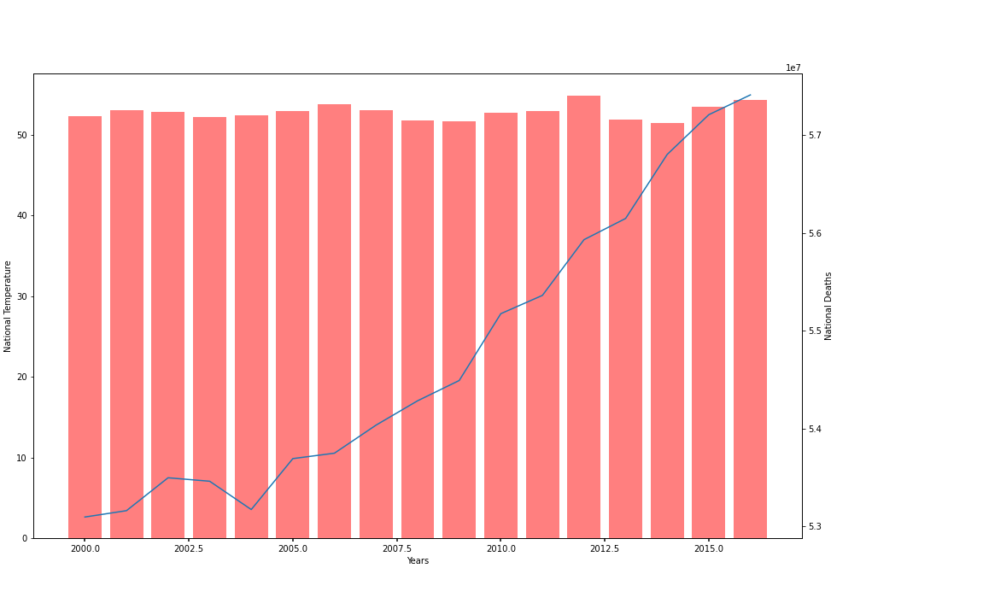
Nationwide - Cancer Deaths and Avg. Temp

Slide 6
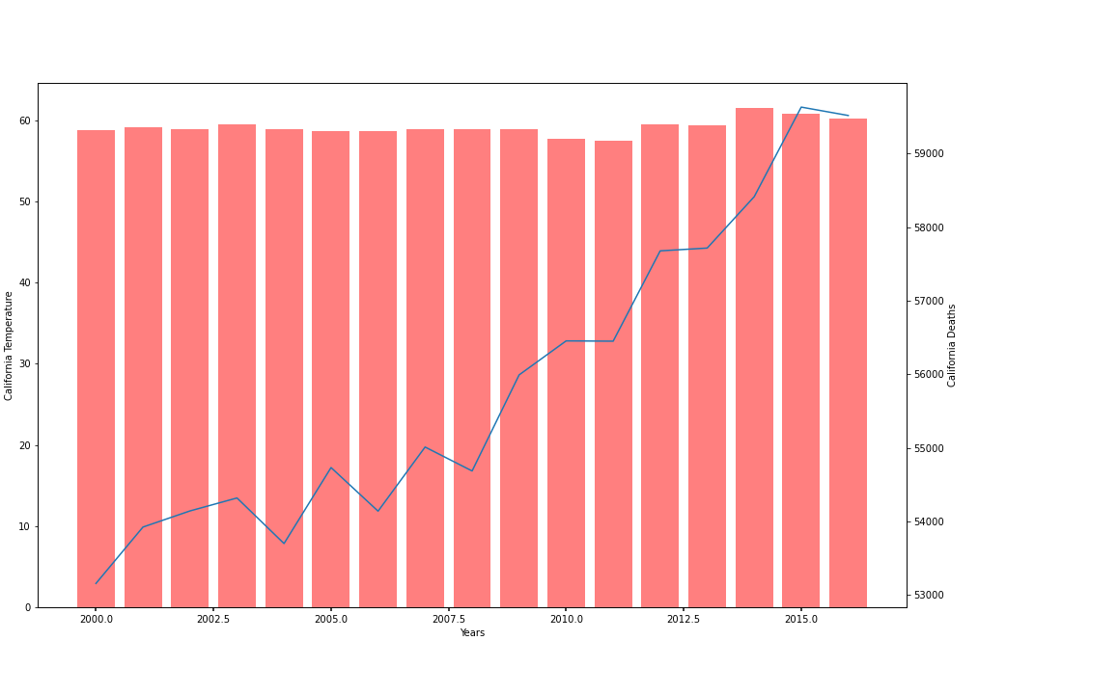
California - Cancer Deaths and Avg. Temp

Slide 7
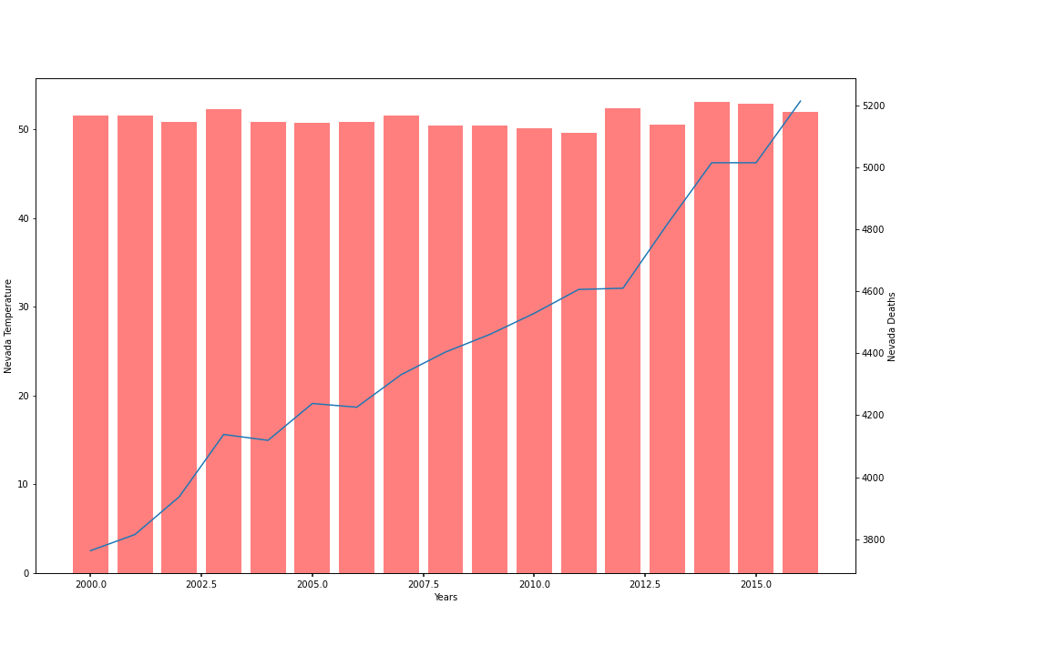
Nevada - Cancer Deaths and Avg. Temp

Slide 8
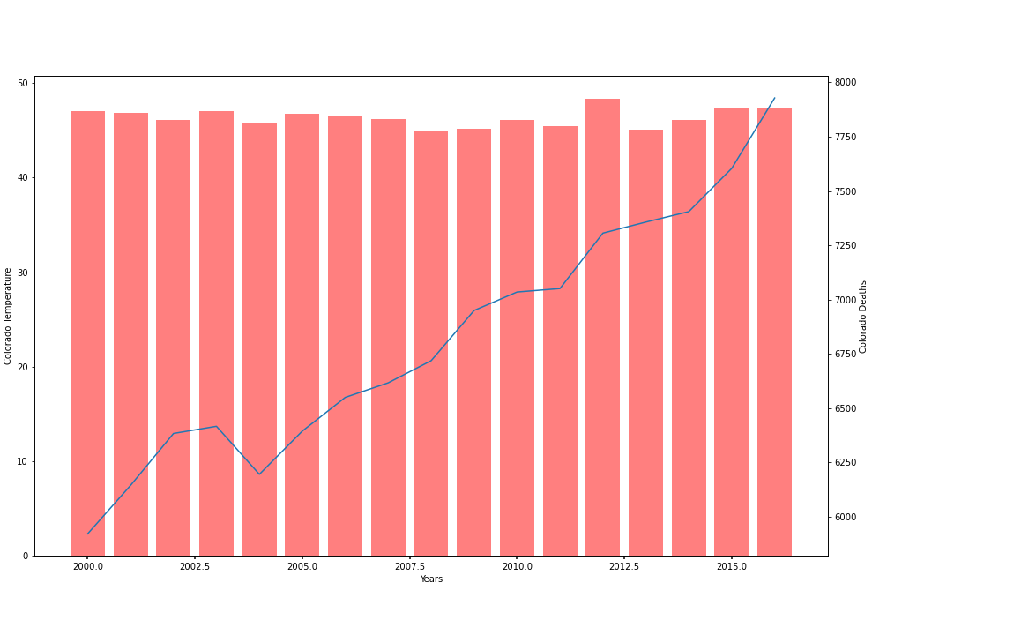
Colorado - Cancer Deaths and Avg. Temp

Slide 9
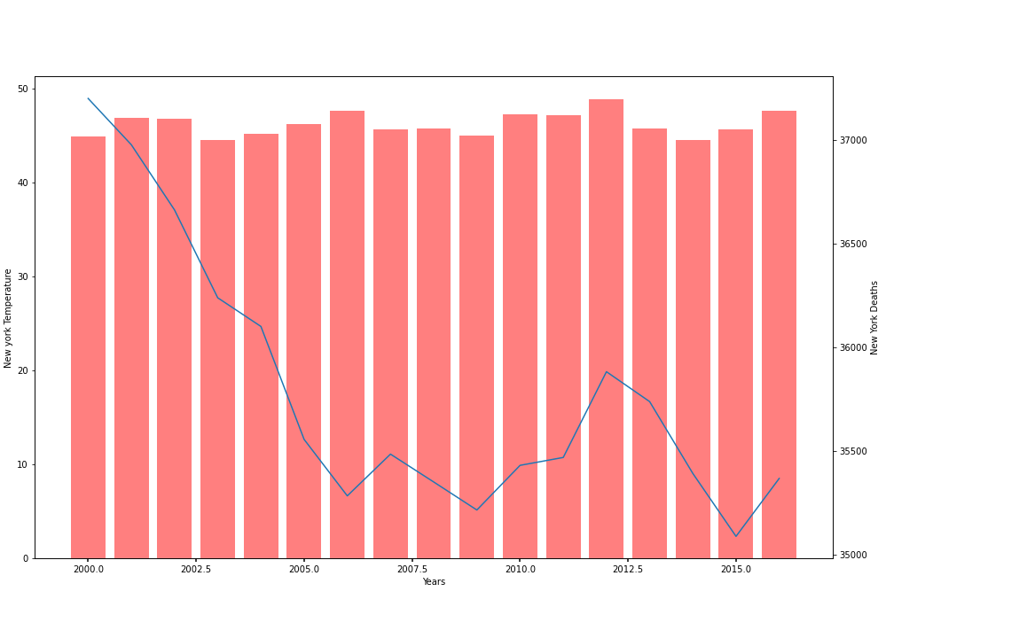
New York - Cancer Deaths and Avg. Temp

Slide 10
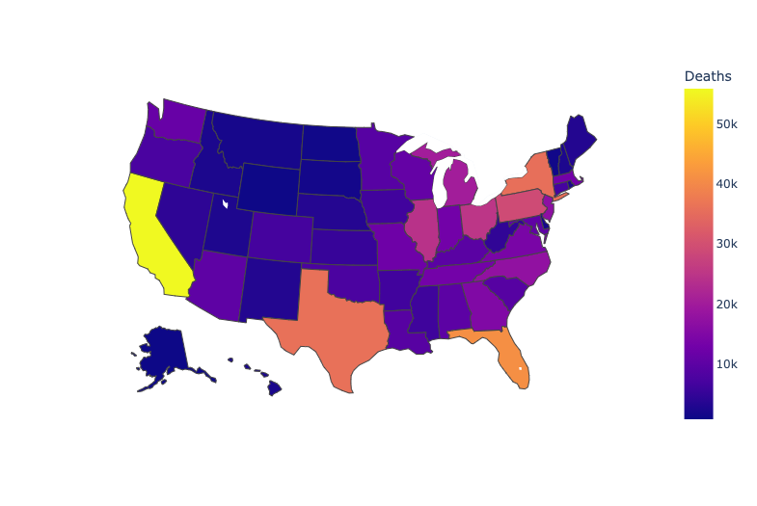
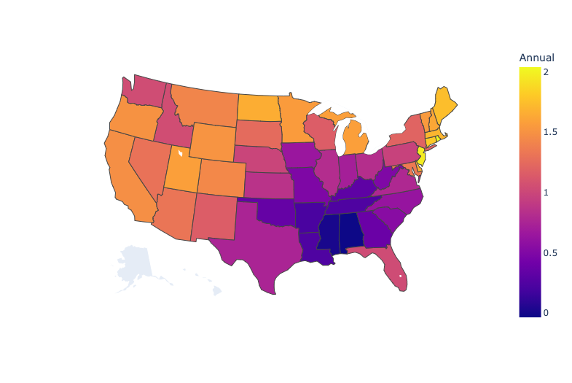
Heatmap for Deaths and Temp. Change

Slide 11
Discussion
Discuss your findings. Did you find what you expected to find? If not, why not? What inferences or general conclusions can you draw from your analysis?
Notes:
Inconclusive to a degree.

Slide 12
Post Mortem
Discuss any difficulties that arose, and how you dealt with them:
Initial Code -> Hard Coded not scalable. Fixed to be consolidated and run optimally.
We used a national mortality rate data set. This included all types of mortality including non-disease related causes. This data was irrelevant to our thesis, so our team had to remove it from the initial datasets. Using Python, we specified cancer related deaths to format our initial code.
Visualizations: Temperature doesn’t look drastic on a graph, however if known 1 degree of temperature has a dramatic difference. We will try to find a better way to show this change in temperature.
Discuss any additional questions that came up, but which you didn't have time to answer: What would you research next, if you had two more weeks? - If we had two more weeks, our team would get more specific on sun-related cancer/diseases. Our data includes all types of cancer, and some may not be related to climate change. However, we would need more time and medical knowledge.
- Source Reference Artifacts

Slide 13
Questions?

